Slide 1
EMADE Viz Progress
Members: Anthony D’Achille, Carissa Ghazalie, Derek Wu, Jeff Minowa, Michael Wang, Wesley Cheung, Will Epperson

Slide 2
Goal
Provide a visual interface to be able to interact with EMADE
Move from only terminal output to graphs that will visualize:
Pareto front
AUC over time
Individual tree structure
Generational progress
Be able to more easily identify which individuals are performing best during training

Slide 3
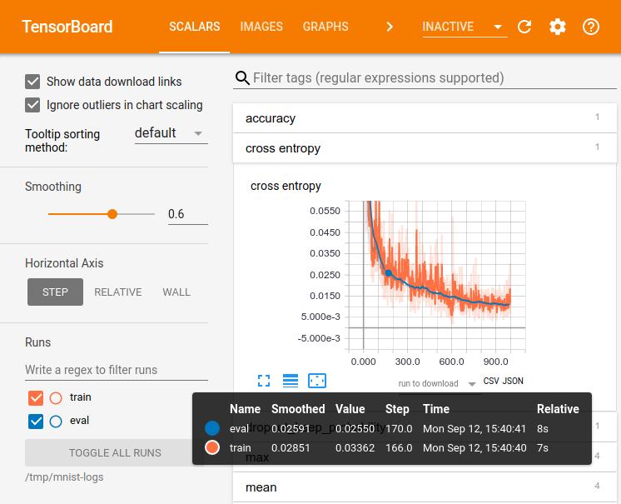
Inspiration: TensorBoard
Notes:
Our goal is to have something similar to tensorboard that lets you see statistics and graphs of evolution process like on the right or inspect individual elements like on the left

Slide 4
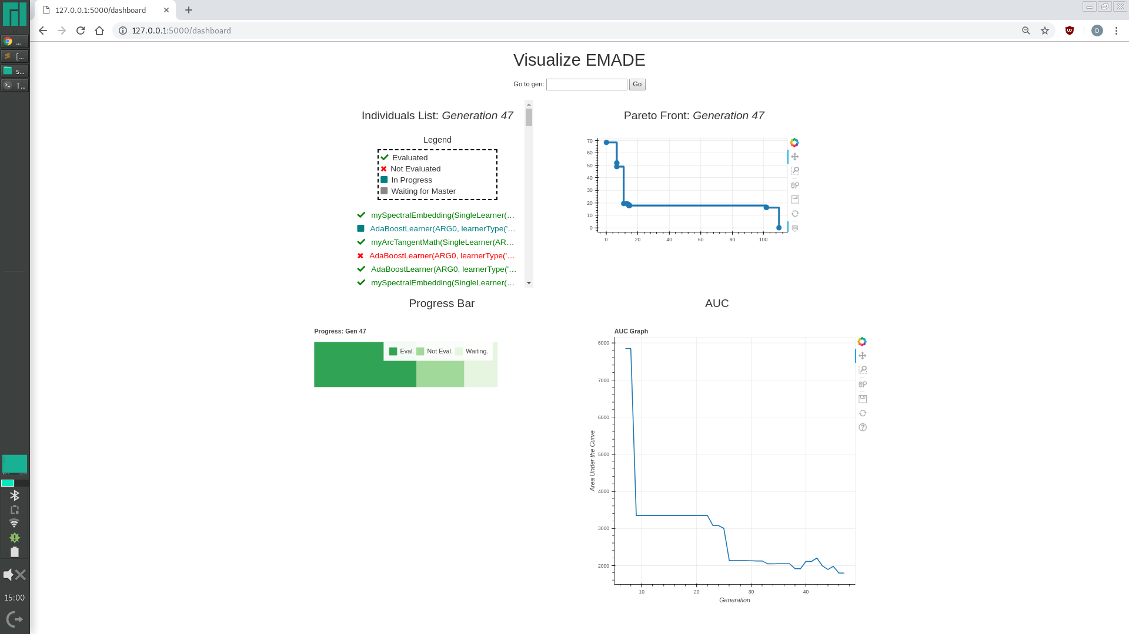
Dashboard View
Includes view of individuals in Generation, Tree visualization, Pareto front, AUC
Flask and Bokeh for app

Slide 5
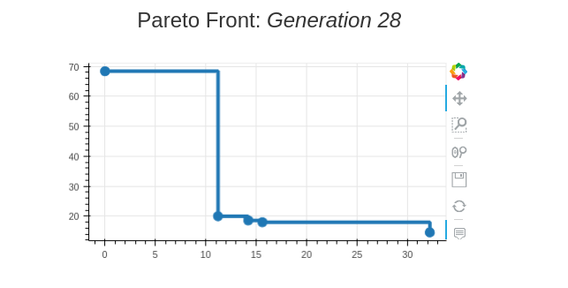
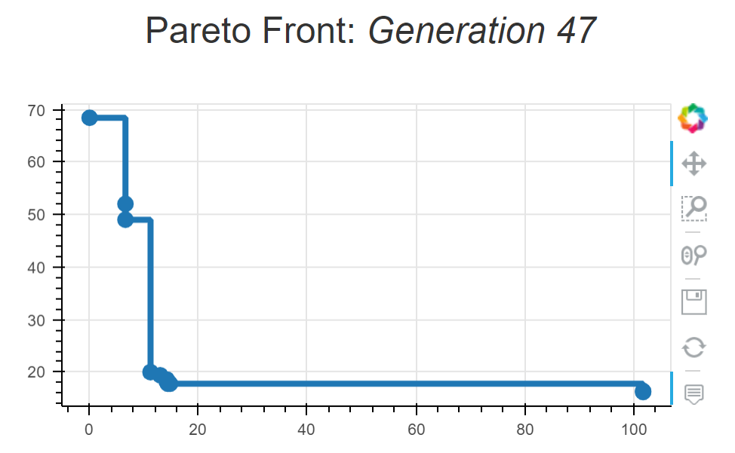
Pareto Front
Creates a pareto front graph for a given generation
The individual can be hovered over and a tree visualization will be displayed for it
Visualization libs: bokeh

Slide 6
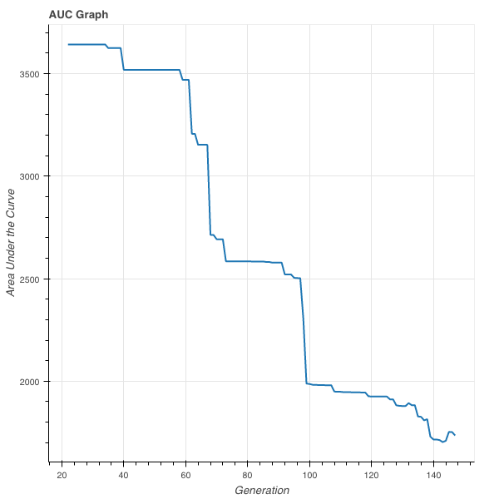
AUC
Calculates the area under the curve for each generation’s pareto front and graphs it over time
Each AUC is calculated using Riemann Sum formula from pareto frontier
Visualization libs: bokeh

Slide 7
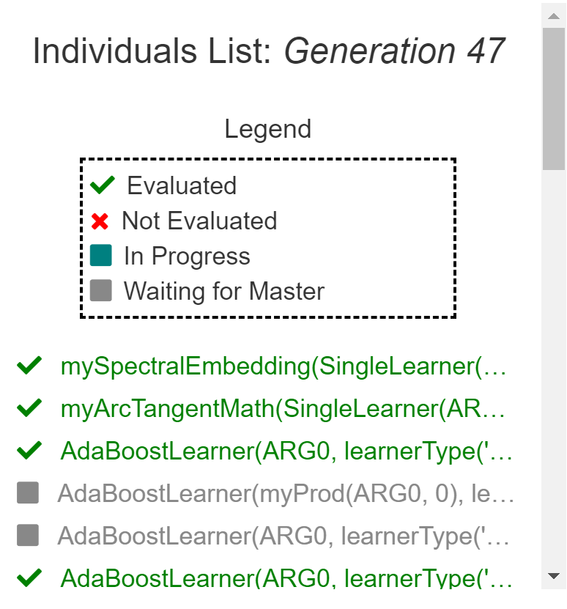
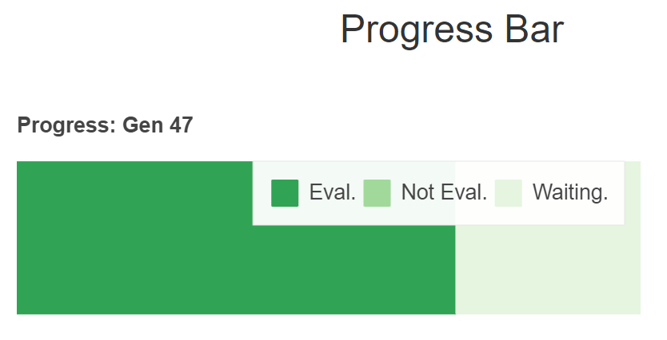
Individuals List & Progress Bar
Individuals List: reads the Individuals Table in the SQL Database and displays the individuals for the current generation, along with their status
Progress Bar: Calculates and displays the overall status of the generation
Visualization libs: matplotlib, bokeh

Slide 8
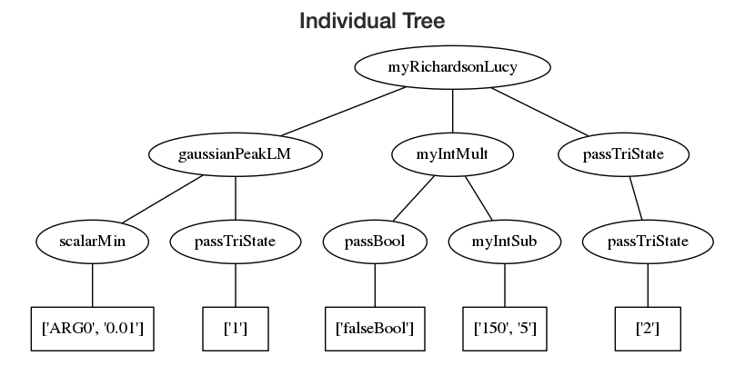
Individual Tree
Takes the Tree string from the DB and parses into a Visualized evaluation tree like at the right
Visualization libs: graphviz and pydot

Slide 9
Where Next?
Merge code into EMADE
Conduct user testing
Create feedback survey and testing document
Have other sub-teams run the application
Get their feedback
Iterate and add features

Slide 10
Questions?

